Slide 1
Recursive Algorithms- Recurrence relations

Slide 2
Recursive Algorithms- Recurrence relations
Recursive algorithm is which calls itself directly or indirectly
Recurrence Relation: “A relation which can be represented by using its previous results”
We use recurrence relations to find the time complexity of Recursive algorithms.
We may reperesent the time taken by recursive algorithms using the equations called recurrence relations , and we find the time complexity of recursive algorithms by solving the recurrence relations

Slide 3
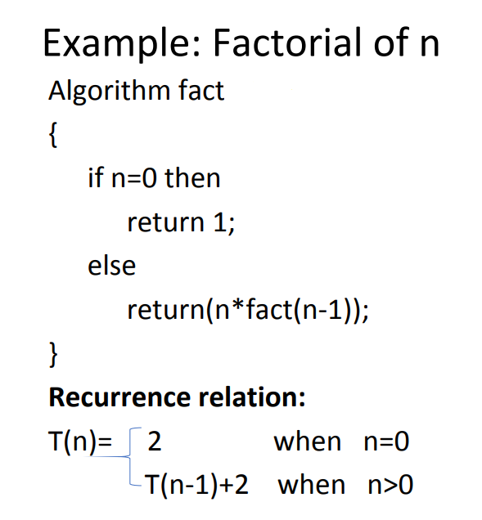

Recurrence Relation

Slide 4
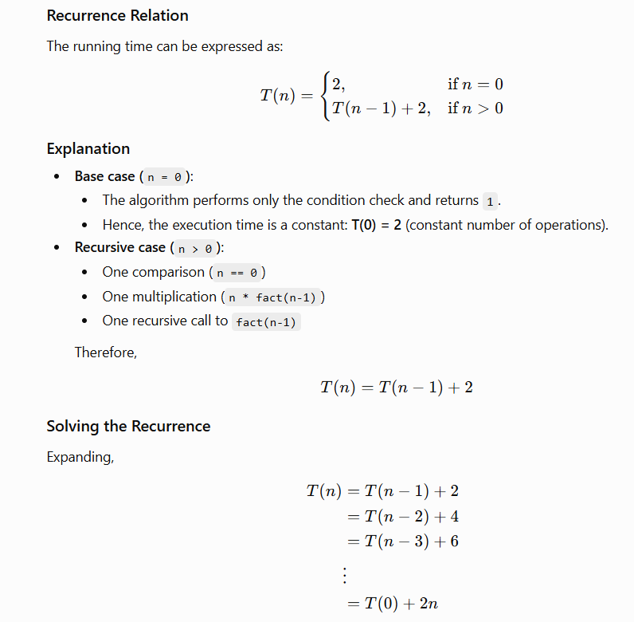

Slide 5
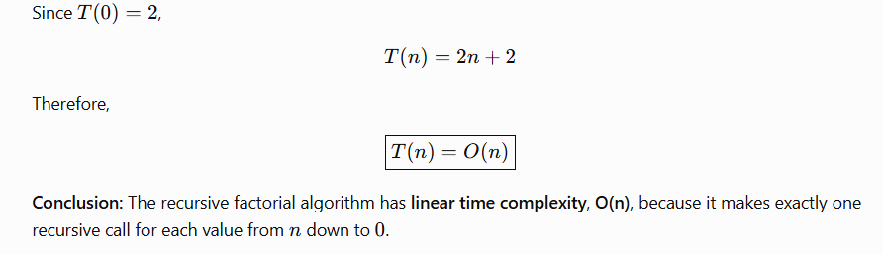

Slide 6
Solving Recurrence Relations
Recurrence relations can be solved by 3 methods
1. Substitution Method: We guess the form of the solution and prove it using mathematical induction.
2. Recursion tree Method: This method represents the recurrence as a tree and computes the total cost by summing the cost at each level.
3. Mastrer’s Method: The Master Theorem provides a direct way to solve divide-and-conquer recurrences of the form: T(n) = aT(n/b) + f(n).

Slide 7
Substitution Method for Recurrences
The Substitution Method is a technique used to find the time complexity of recursive algorithms by expanding the recurrence relation, identifying a pattern, and then proving the result using mathematical induction.
Understand how the recursion works.
Write the recurrence relation.
Guess the solution based on the recursion pattern.
Verify the guessed solution using Mathematical induction

Slide 8
Substitution Method
void fun(int n) {
if (n <= 0)
return;
cout << "GFG";
fun(n / 2);
fun(n / 2);
}
Understanding the Recursion for This Code
The function prints "GFG" once for each call.
It makes two recursive calls, each with input size n/2.
The recursion stops when n <= 0.
Writing the Recurrence Relation
The work done in each function call is constant (printing "GFG"), and the function makes two recursive calls of size n/2. Therefore, the recurrence relation is: T(n) = 2T(n/2) + O(1)

Slide 9
Applying the Substitution Method
To guess the solution of the recurrence, we analyze the number of recursive calls made by the function. Each function call performs only constant work and splits the problem into two subproblems of size n/2. As the recursion continues, the number of function calls doubles at each level, and the recursion stops when the input size becomes constant, which happens after about log n levels.
Hence, we guess that the time complexity is T(n) = O(n).
Now, we verify this guess. Assume that for some constant c > 0: T(n) ≤ cn
Assume that this holds for smaller values of n, particularly for n/2: T(n/2) ≤ c(n/2)
Substituting into the recurrence relation: T(n) = 2T(n/2) + O(1) ≤ 2 · c(n/2) + O(1) = cn + O(1) For sufficiently large values of n, the constant term is dominated by cn. Thus, T(n) ≤ cn
Result: The assumption holds true, which confirms that the time complexity of the recurrence is: T(n) = O(n)

Slide 10
The recursion tree method
The recursion tree method is used to analyze the time complexity of recursive algorithms by visually representing the recurrence as a tree. Each node of the tree represents the work done in a single recursive call, and each level represents one stage of the recursion. Below are the steps used to find time complexity using recursion tree method.
Draw a recursive tree for given recurrence relation
Calculate the cost at each level and count the total no of levels in the recursion tree.
Sum up the cost of all the levels in the recursive tree

Slide 11
void fun(int n) {
if (n <= 1)
return;
fun(n / 2);
fun(n / 2);
for (int i = 0; i < n; i++) {
cout << "GFG ";
}
}
Understanding the Recursion for This Code
The function makes two recursive calls, each on a subproblem of size n/2. After both recursive calls return, it performs a loop that prints "GFG" exactly n times, which is linear work for each function call. The recursion stops when n ≤ 1.
Writing the Recurrence Relation
Each function call makes two recursive calls of size n/2 and performs linear work after the recursion. Therefore, the recurrence relation is: T(n) = 2T(n/2) + O(n)

Slide 12
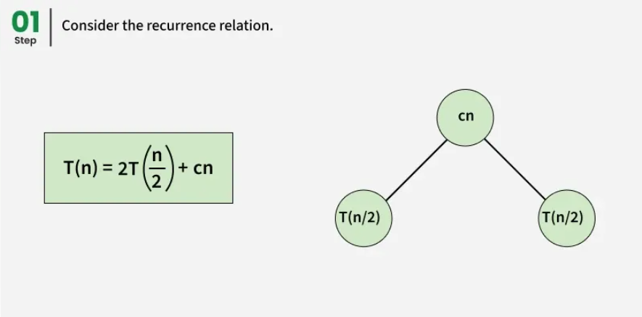
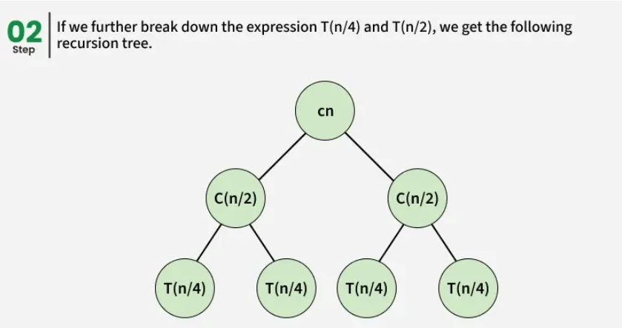

Slide 13
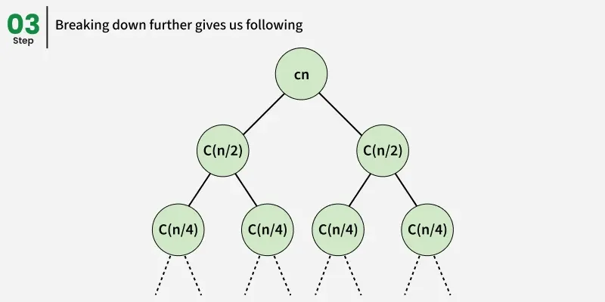

Slide 14
To find T(n), we analyze the recursion tree and sum the cost at each level.
Level 0: The root contributes a cost of cn.
Level 1: The subproblems are of sizes n/2 and n/2. Their total cost is: c(n/2)+ c(n/2) = cn
Level 2: There are four subproblems of size n/4. Continuing this way, the work at each level reamains cn.
Total Work Across All Levels
The input size halves at each level, and the recursion stops when the size becomes constant. Hence, the height of the recursion tree is log ⁡n.
Since each level contributes a cost of cn, the total work is: T(n) = cn + cn + ....... + cn (log n levels) T(n) = cn log n
Final Result: T(n) = O(n log n)

Slide 15

Master Theorem for Divide and Conquer Recurrences
The Master Theorem is a tool used to solve recurrence relations that arise in the analysis of divide-and-conquer algorithms.
where:
n is the size of the problem
a ≥ 1 is the number of subproblems
n/b is the size of each subproblem (b > 1)
f(n) is the cost of work done outside the recursive calls (dividing the problem and combining results)

Slide 16
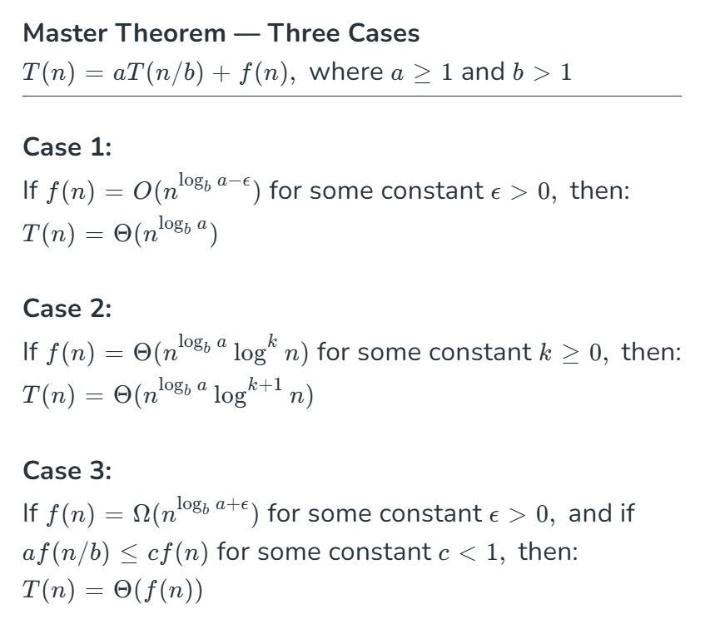

Slide 17
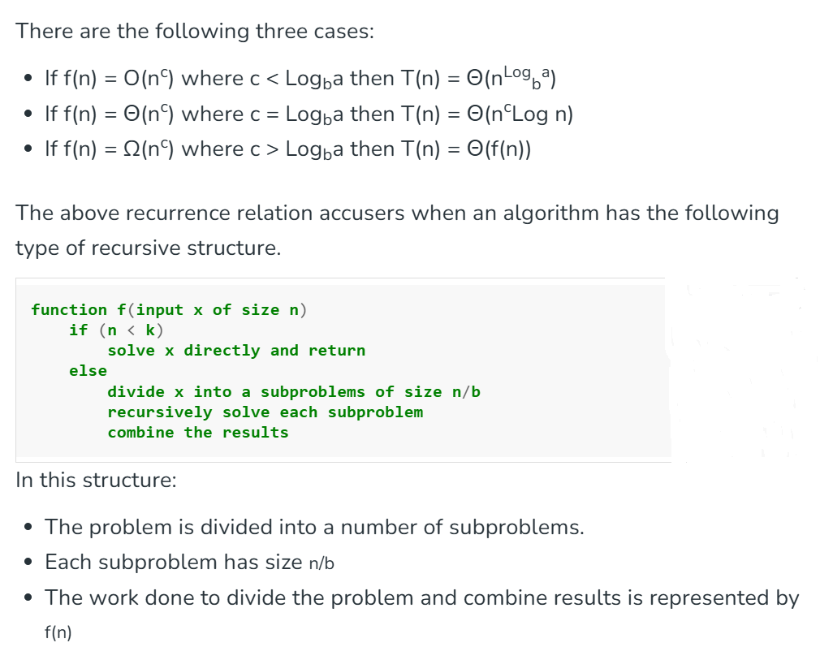

Slide 18
Hence, the running time can be expressed as:
T(n) = aT(n/b) + f(n)
When Master Theorem Cannot Be Applied
The Master Theorem does not apply in the following cases:
If T(n) is not monotonic Example: T(n) = sin⁡(n)
If f(n) is not a polynomial or does not fit the required form Example: T(n) = 2T(n/2) + 2^{n}

Slide 19
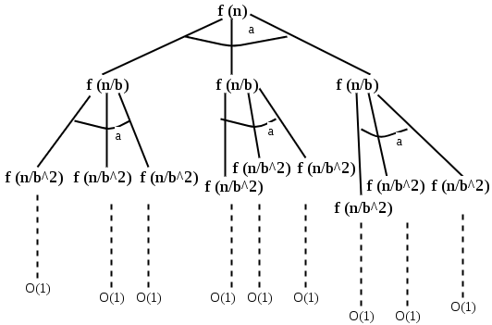
How does the theorem work?
The master method is mainly derived from the recurrence tree method. If we draw the recurrence tree of T(n) = aT(n/b) + f(n), we can see that the work done at the root is f(n), and work done at all leaves is O(n^{c}) where c is Log_{b}a. And the height of the recurrence tree is Log_{b}n

Slide 20
In the recurrence tree method, we calculate the total work done. If the work done at leaves is polynomially more, then leaves are the dominant part, and our result becomes the work done at leaves (Case 1). If work done at leaves and root is asymptotically the same, then our result becomes height multiplied by work done at any level (Case 2). If work done at the root is asymptotically more, then our result becomes work done at the root (Case 3).
Key Points
The Master Theorem is specifically designed for divide-and-conquer recurrences
It applies only to recurrences of the form:
T(n) = aT(n/b) + f(n)
It provides a quick and reliable way to compute asymptotic time complexity
Not all recurrences can be solved using this method
For unsupported cases, we either use Substitution Method or Recurrence Tree Method

Slide 21
Amortized Analysis
Amortized analysis studies the average cost of operations over a sequence, rather than focusing on the worst-case of a single operation.
It is especially useful for dynamic data structures like arrays, hash tables, and trees, where occasional expensive operations occur.
By spreading the cost of rare costly operations across many cheap ones, it gives a realistic measure of algorithm efficiency.

Slide 22
Example: In a dynamic array, inserting elements is usually cheap (O(1)), but occasionally the array needs resizing, which is costly. By spreading the cost of resizing over all insertions, the amortized cost per insertion remains O(1).
Techniques of Amortized Analysis
There are three standard methods to perform amortized analysis:
1. Aggregate Method
Compute the total cost of 𝑛th operations and divide it by number of operations to obtain the average cost..
Example: Dynamic array insertions involve occasional costly resizes, but the average cost per insertion is low.

Slide 23
2. Accounting Method
Assign credits to operations.
Cheap operations save credits to pay for future expensive operations.
3. Potential Method
Define a potential function φ representing the “stored work” in a data structure.
Amortized cost = actual cost + change in potential.
Commonly used in balanced trees like Red-Black Trees.

Slide 24
The solution is to increase the table size whenever it's full. Here are the steps:
Allocate memory for a larger table, typically twice the size of the old table.
Copy the contents of the old table to the new table.
Free the old table.
If space is available, insert a new item.

Slide 25
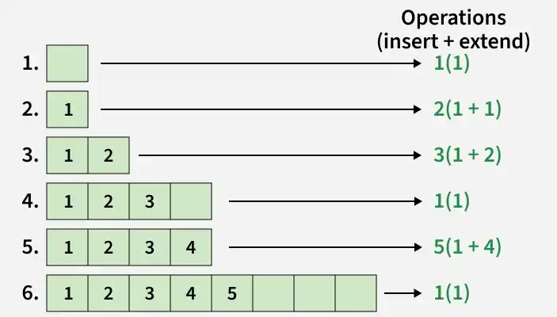
Time Complexity: If simple analysis is used, the worst-case insertion cost is O(n). Therefore, the worst-case cost for n insertions is n * O(n), which is O(n^2). However, this analysis provides an upper bound that isn't tight for n insertions, as not all insertions take O(n) time.

Slide 26
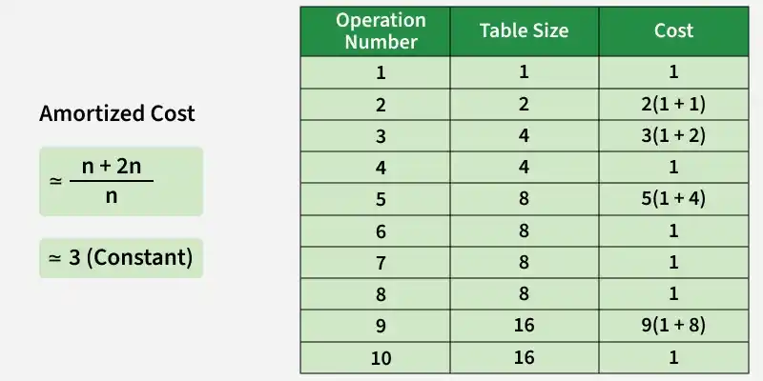
Amortized Analysis proves the Dynamic Table scheme has O(1) insertion time

Slide 27
